Slide 1

Embedded Systems (Software)
Kavi Arya
CSE Dept.
IIT-Bombay

Slide 2






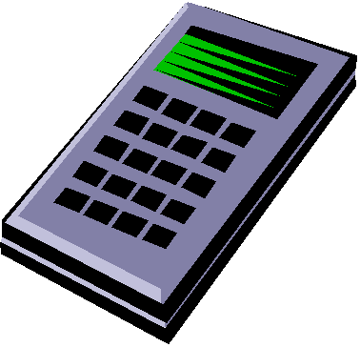







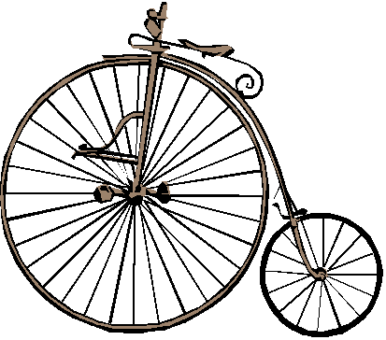
Beware of the computer!
From computers to embedded & networked SoCs … IoT
Complete change in device interaction
Growing number of critical applications

Slide 3
Computing without Computers (or, the changing nature of computers or, where/what is hardware?)
Notes:
56

Slide 4
Computing without Computers*
Changes in how we design/ deliver compute power
Reconfigurable computing and custom computing
i.e. turn sw into hw =>speed up (no single processor to slow us)
Multi-core chips
Today’s computer chips surrounded by other cores
Graphics processing, display handling, network interfacing, sound generation, wireless comm., etc.
Supported by a range of functions embedded in hardware.
*Prof. Ian Page, University of Oxford, 1990’s

Slide 5
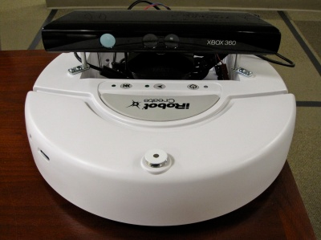
Changes Happening
New ways of designing/delivering computer capability
PCs, mobile phones, etc.
Microsoft gaming sensor Kinect to become eyes/ears of robots
Changing structure of electronics & computing industry
Largest manufacturer of cameras?
Changing products that people buy as well as the way that they buy and use them
Tape-recorder -> Walkman -> digital players -> iPod -> …
Books -> ebooks -> …
Mainframe -> minicomps -> PCs -> servers -> cloud -> services
Changing how money made out of delivering value to customers
Products changing into services
Potentially deep & far-ranging effects of energy use & sustainability

Slide 6
Technological & economic drivers of change
Nature of silicon industry
Extraordinary consequences of Moore’s Law.
Focus moving away from ASIC (application specific chip) technology towards standard chip products and thus lower prototype costs
Big winner: reconfigurable hardware - in particular FPGA chips
Can reduce the $6M development cost of a new chip to a few dollars and a few days

Slide 7
Internet of Things (IoT)

Slide 8
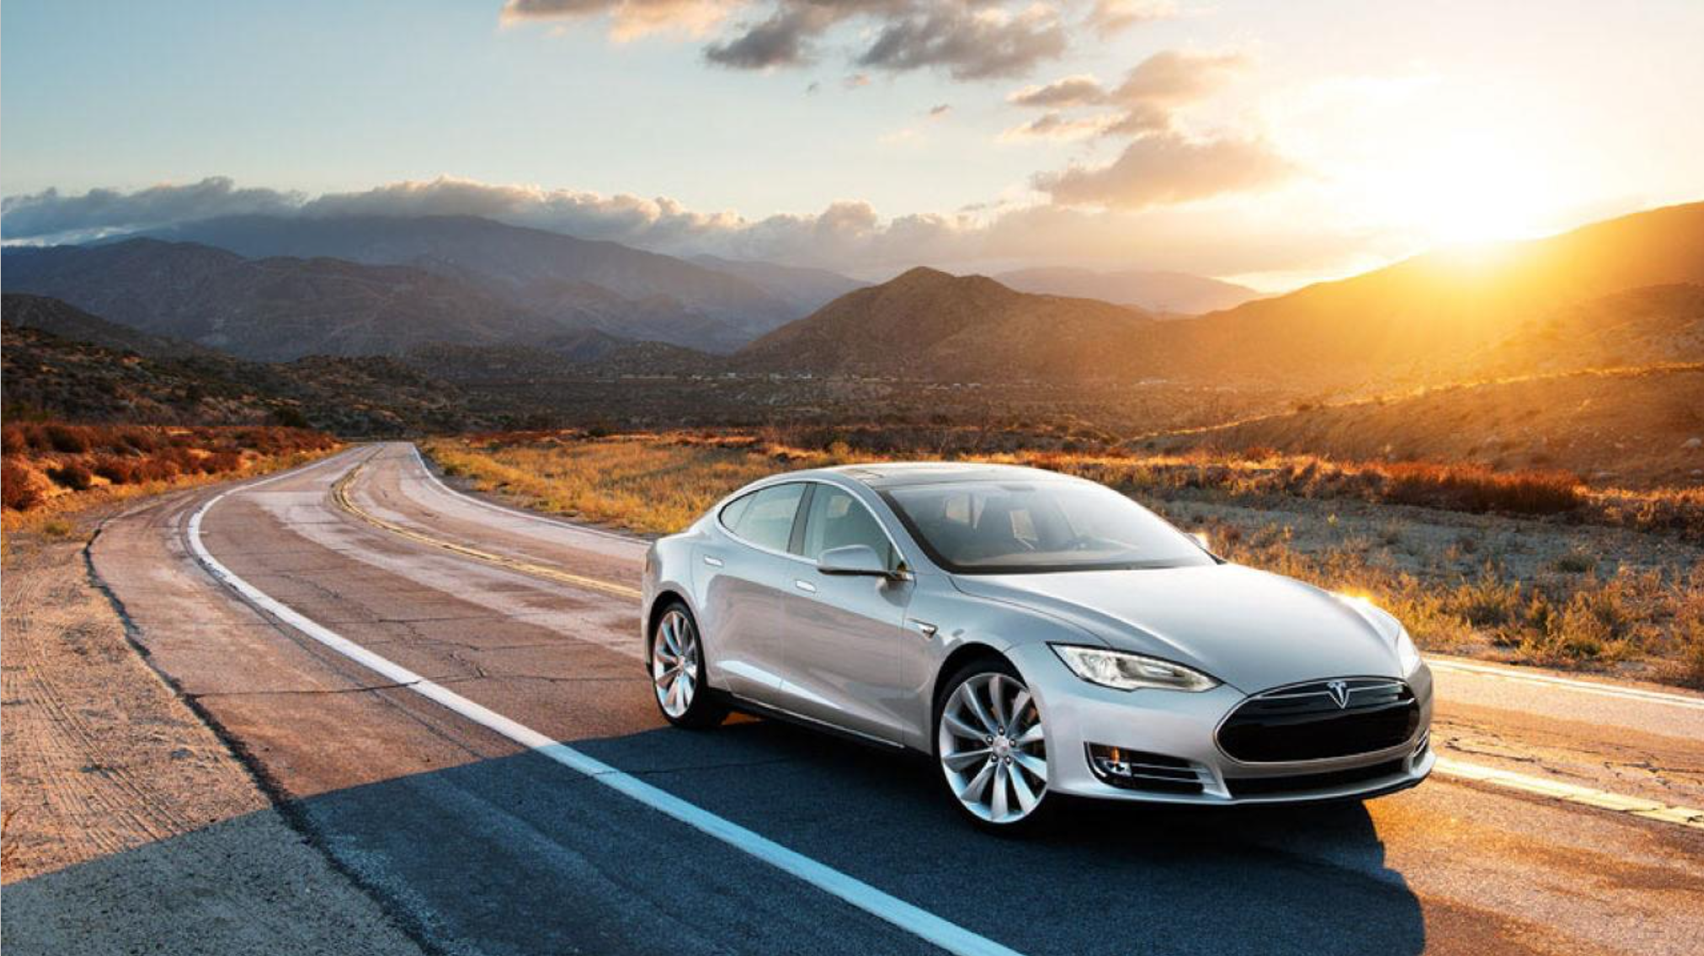
Internet of Things
The Shape of Things to Come… IoT

Slide 9
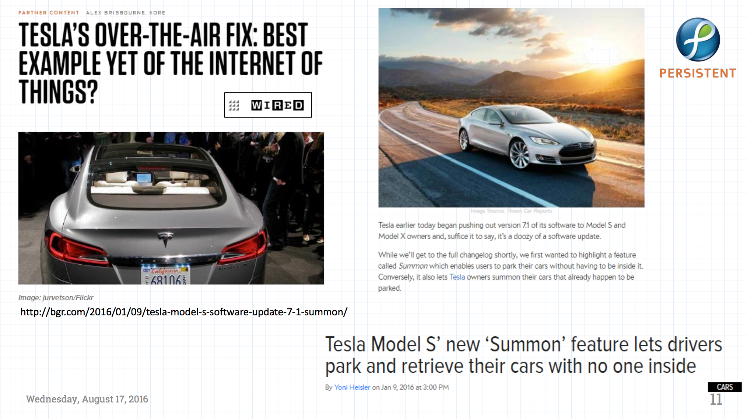
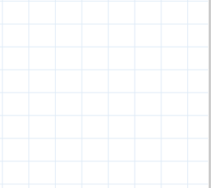

Slide 10
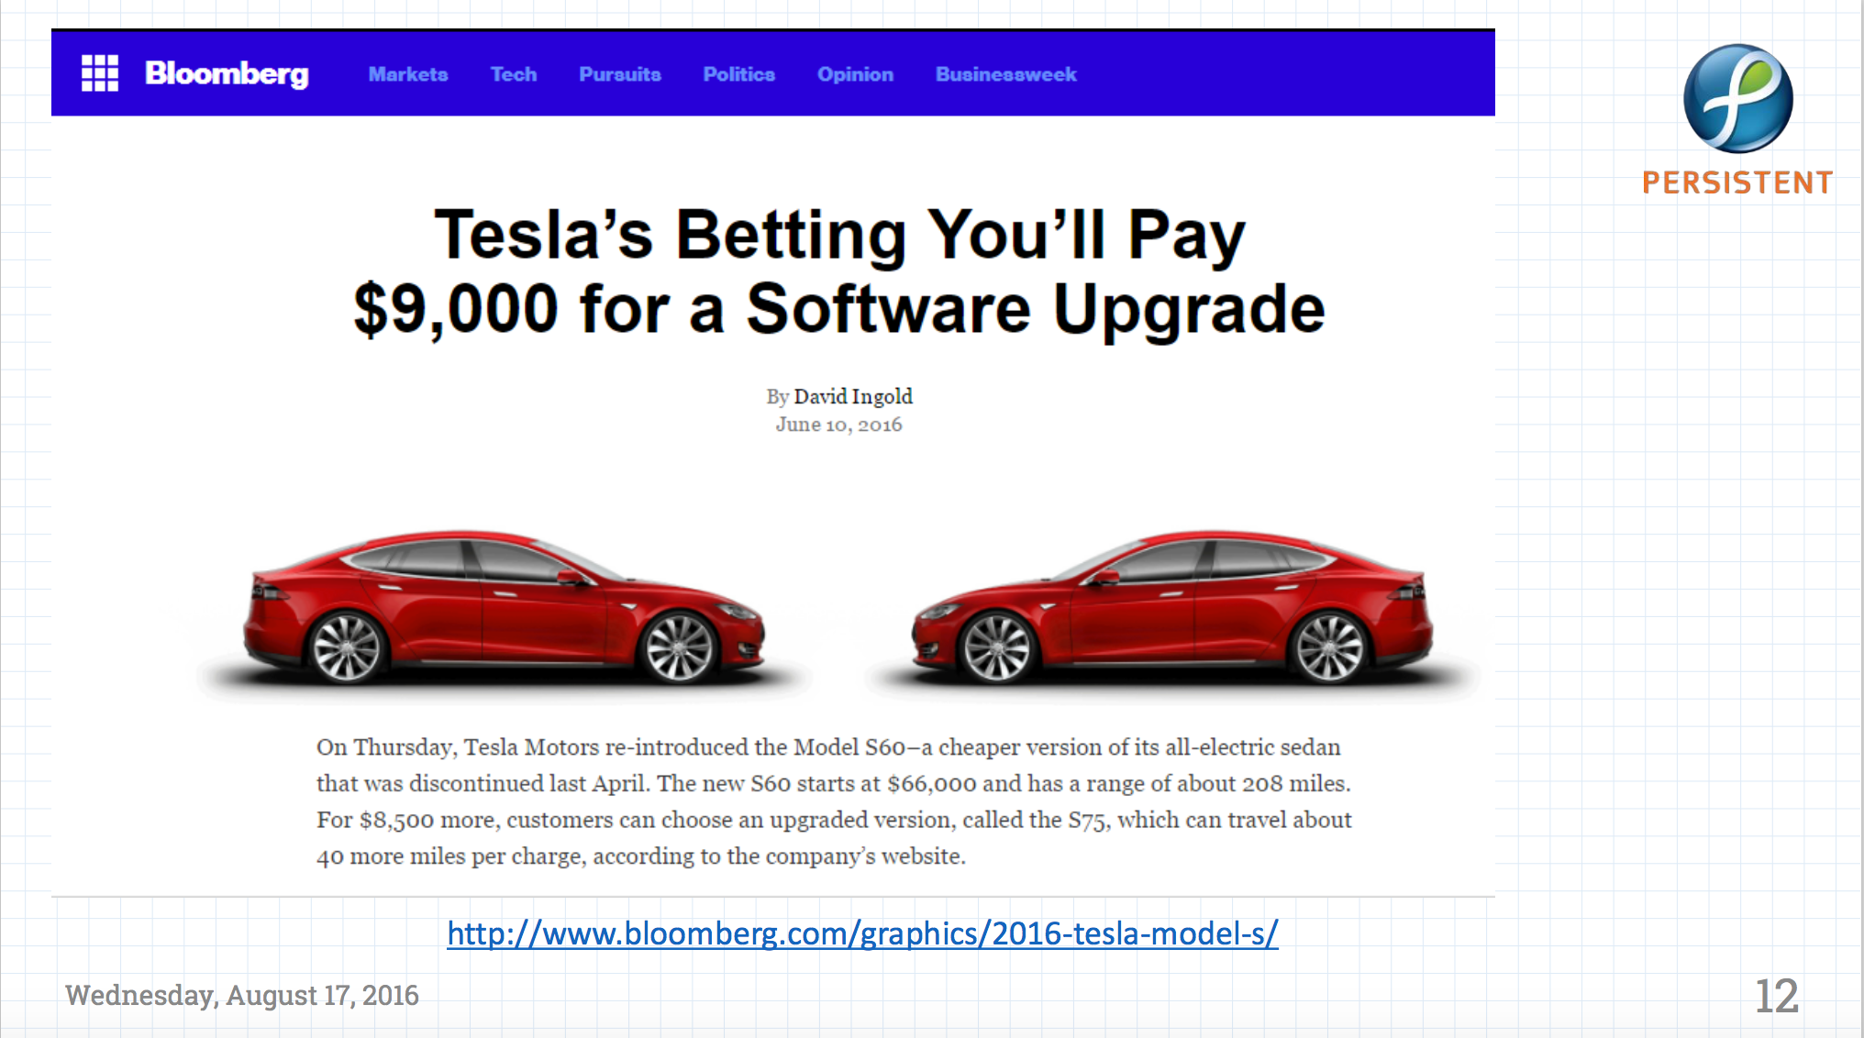
Notes:
10

Slide 11
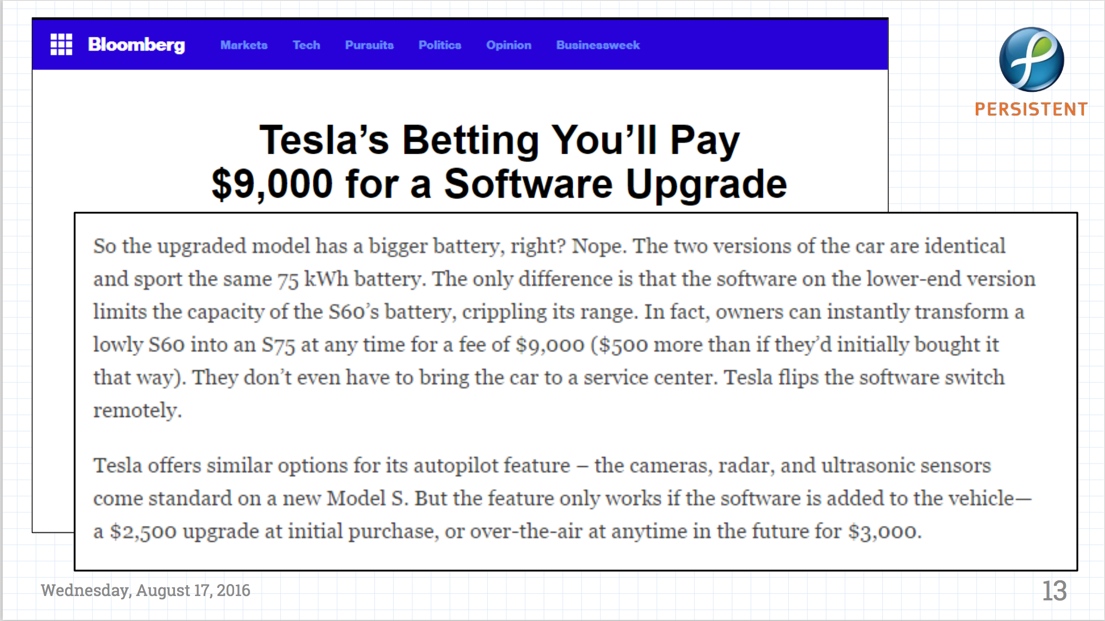

Slide 12
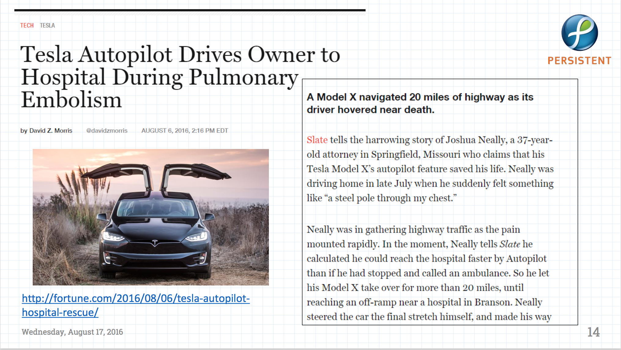

Slide 13
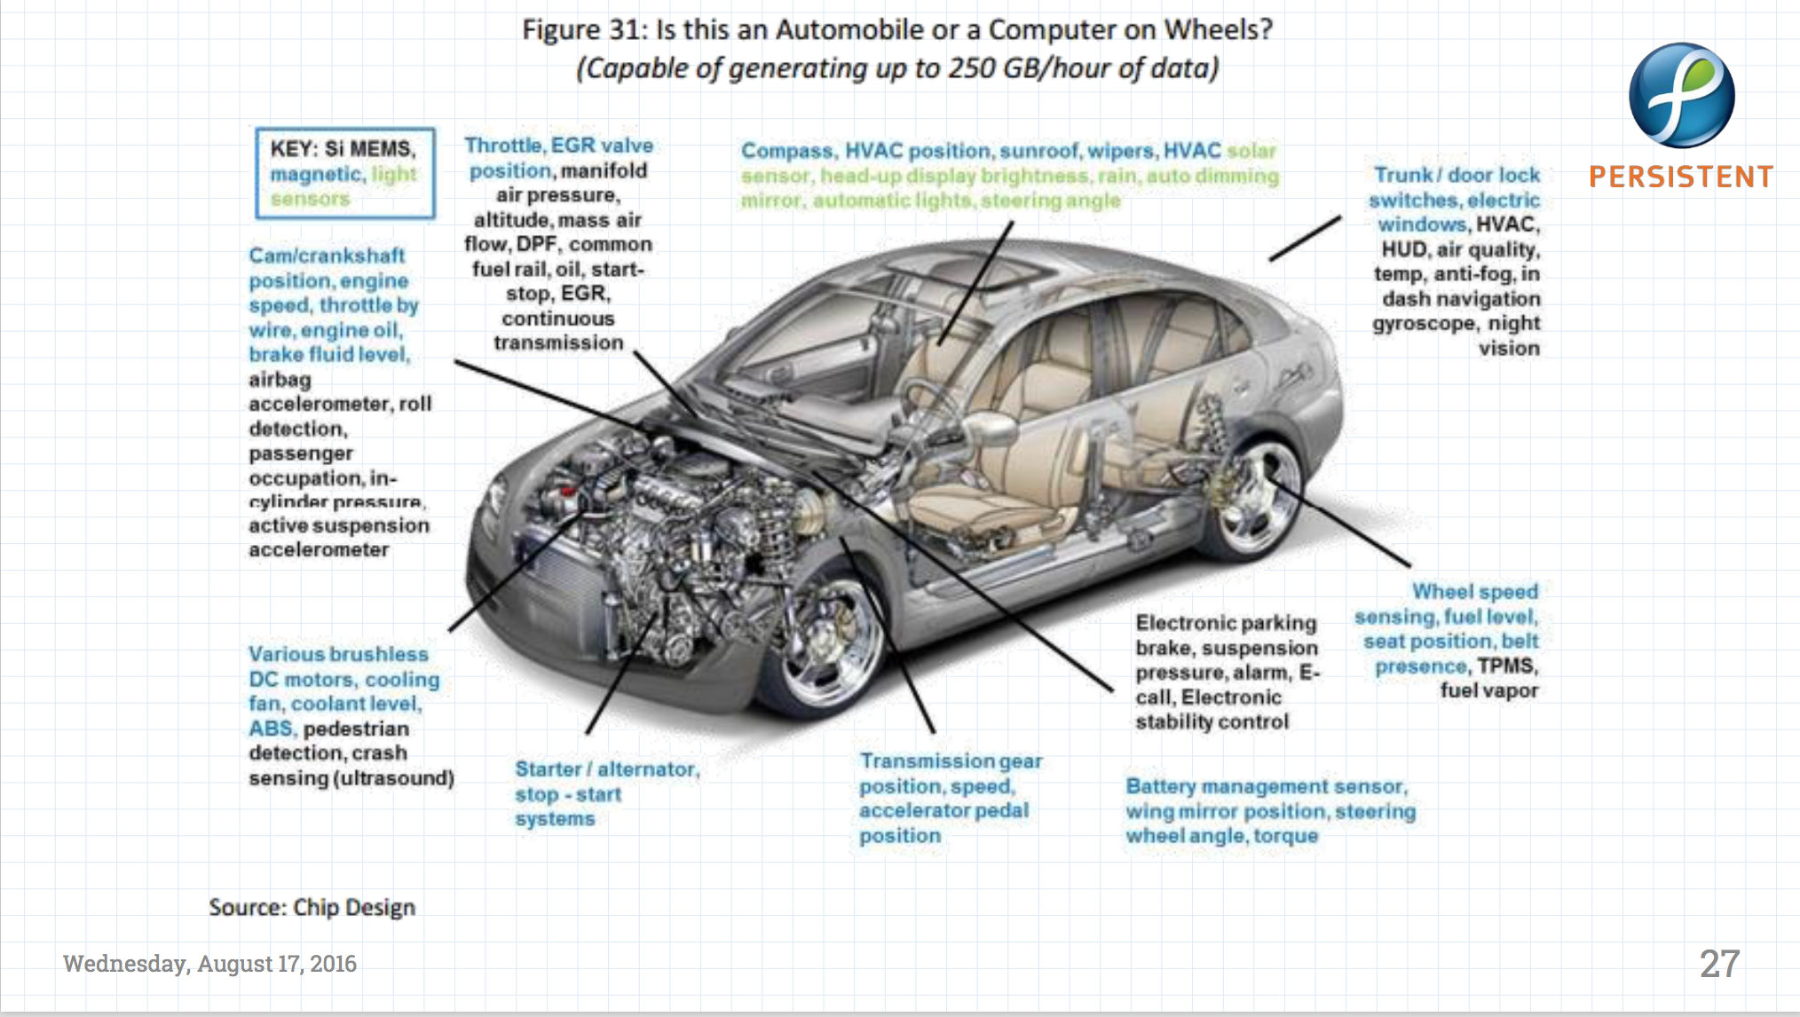

Slide 14
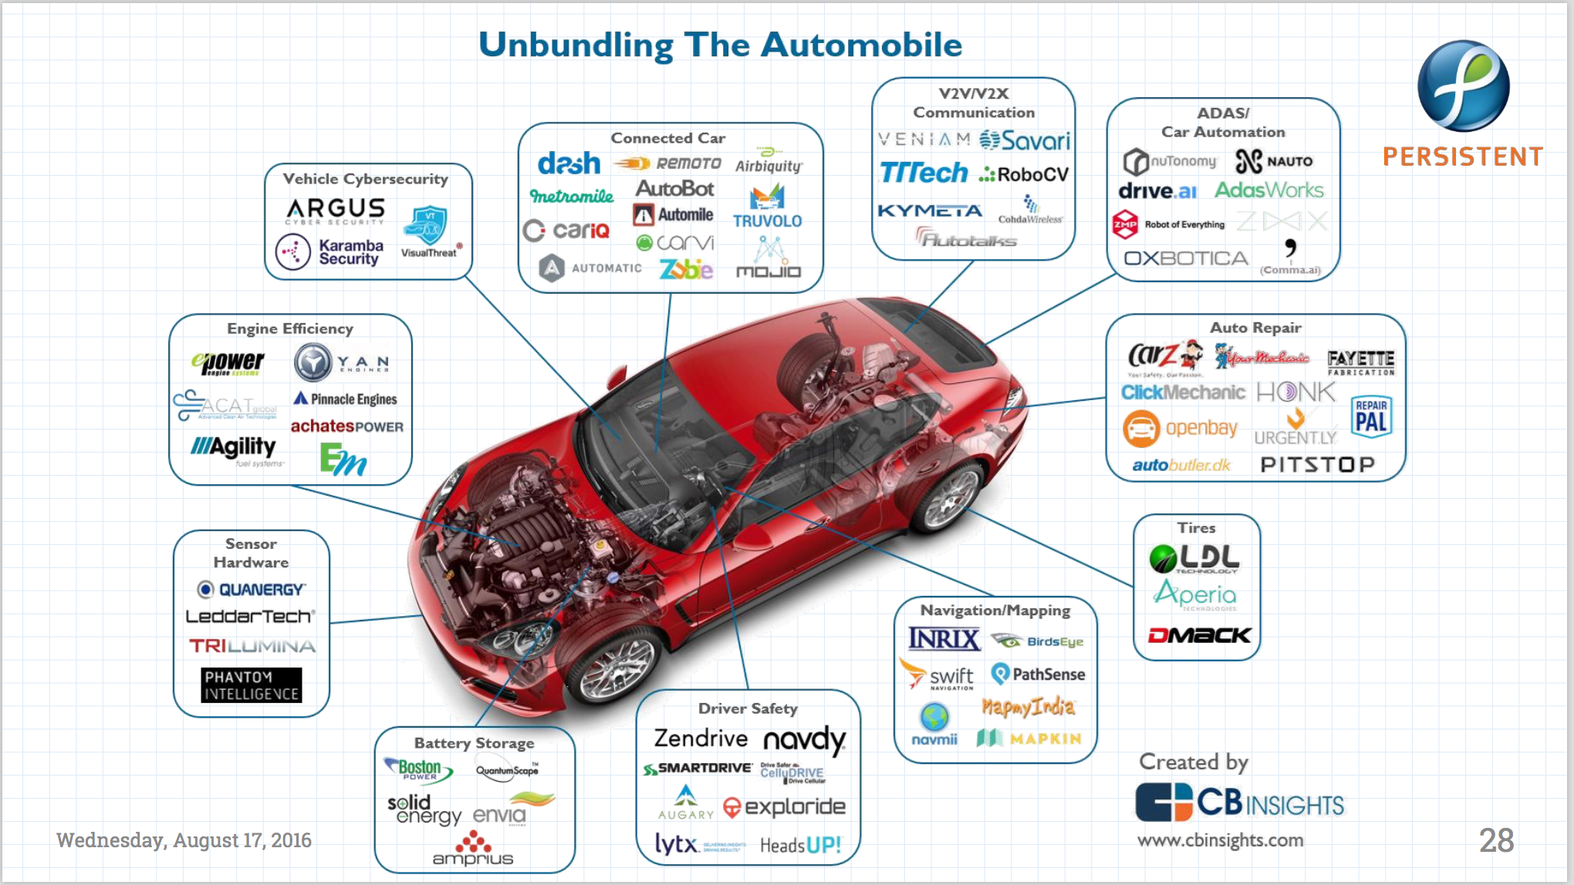

Slide 15
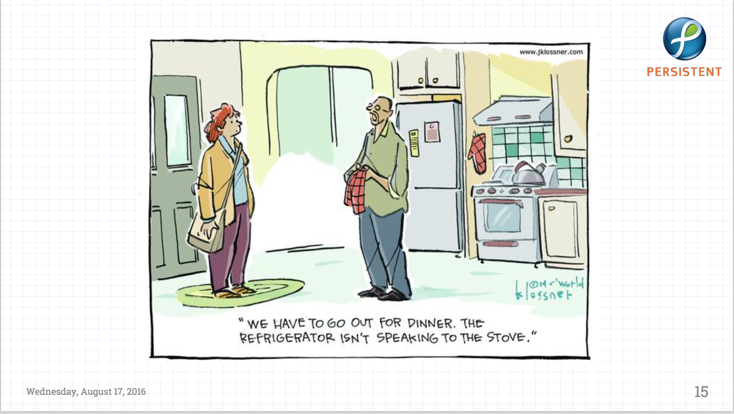
Soon there will be no maids!! Then What?

Slide 16
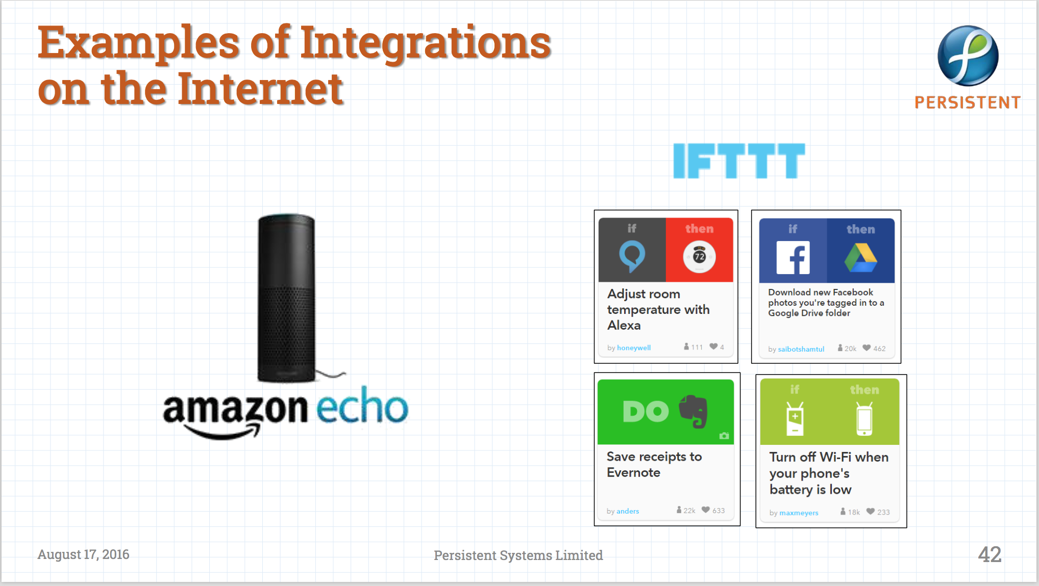

Slide 17
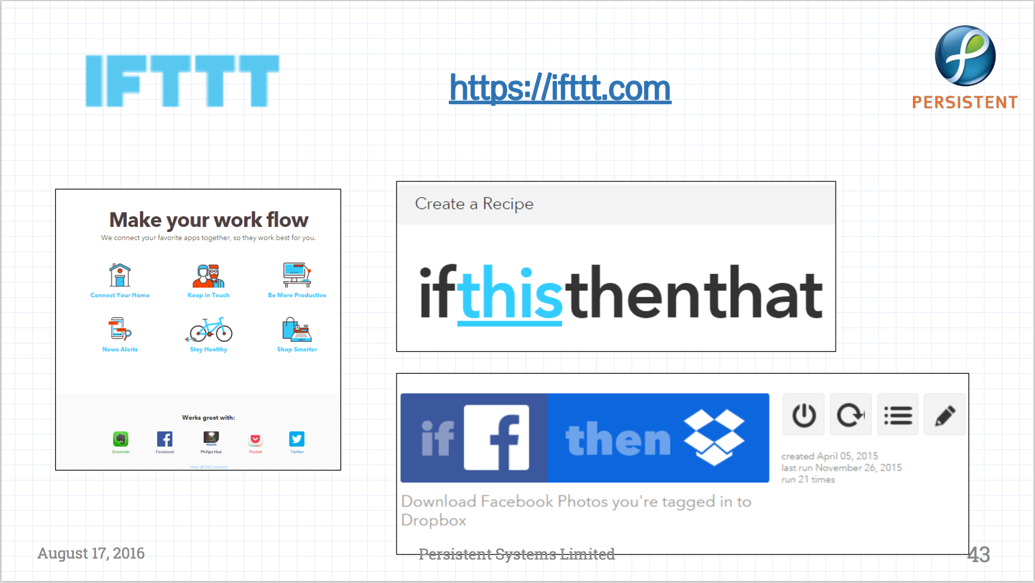

Slide 18
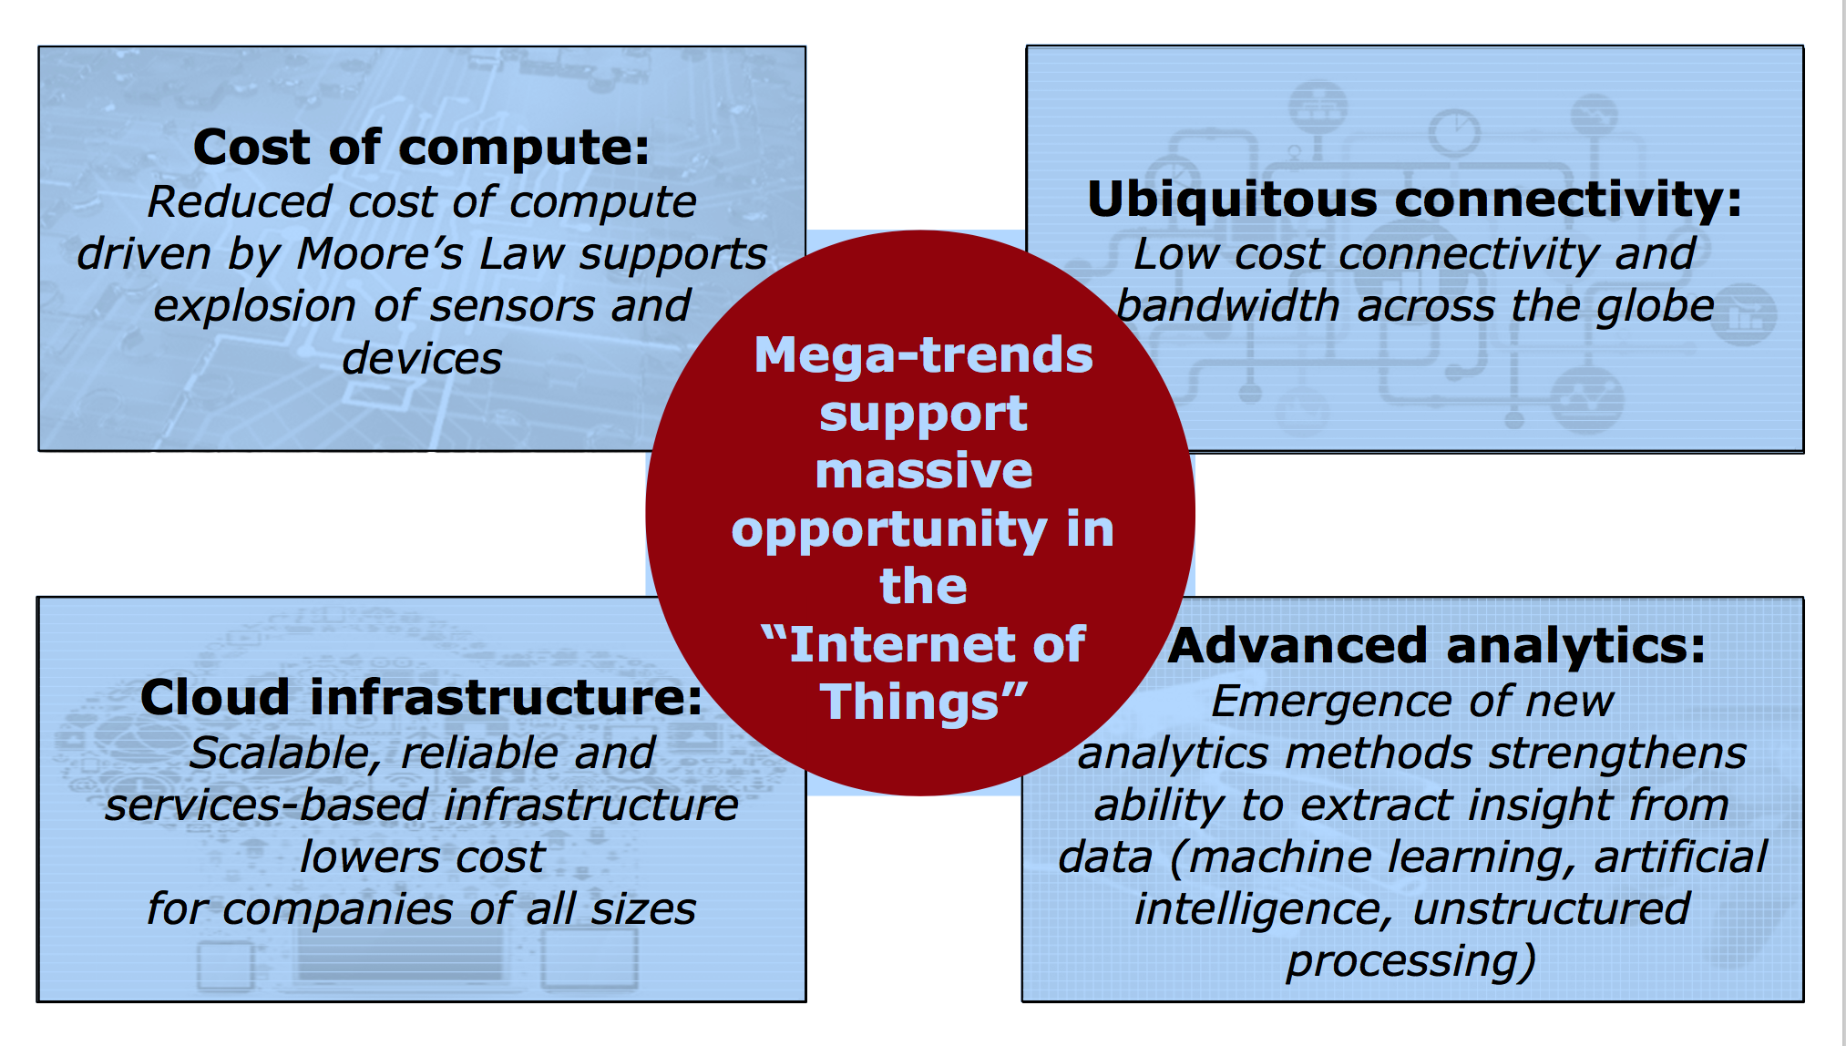
IoT & Analytics being fueled by Technology Advancements

Slide 19
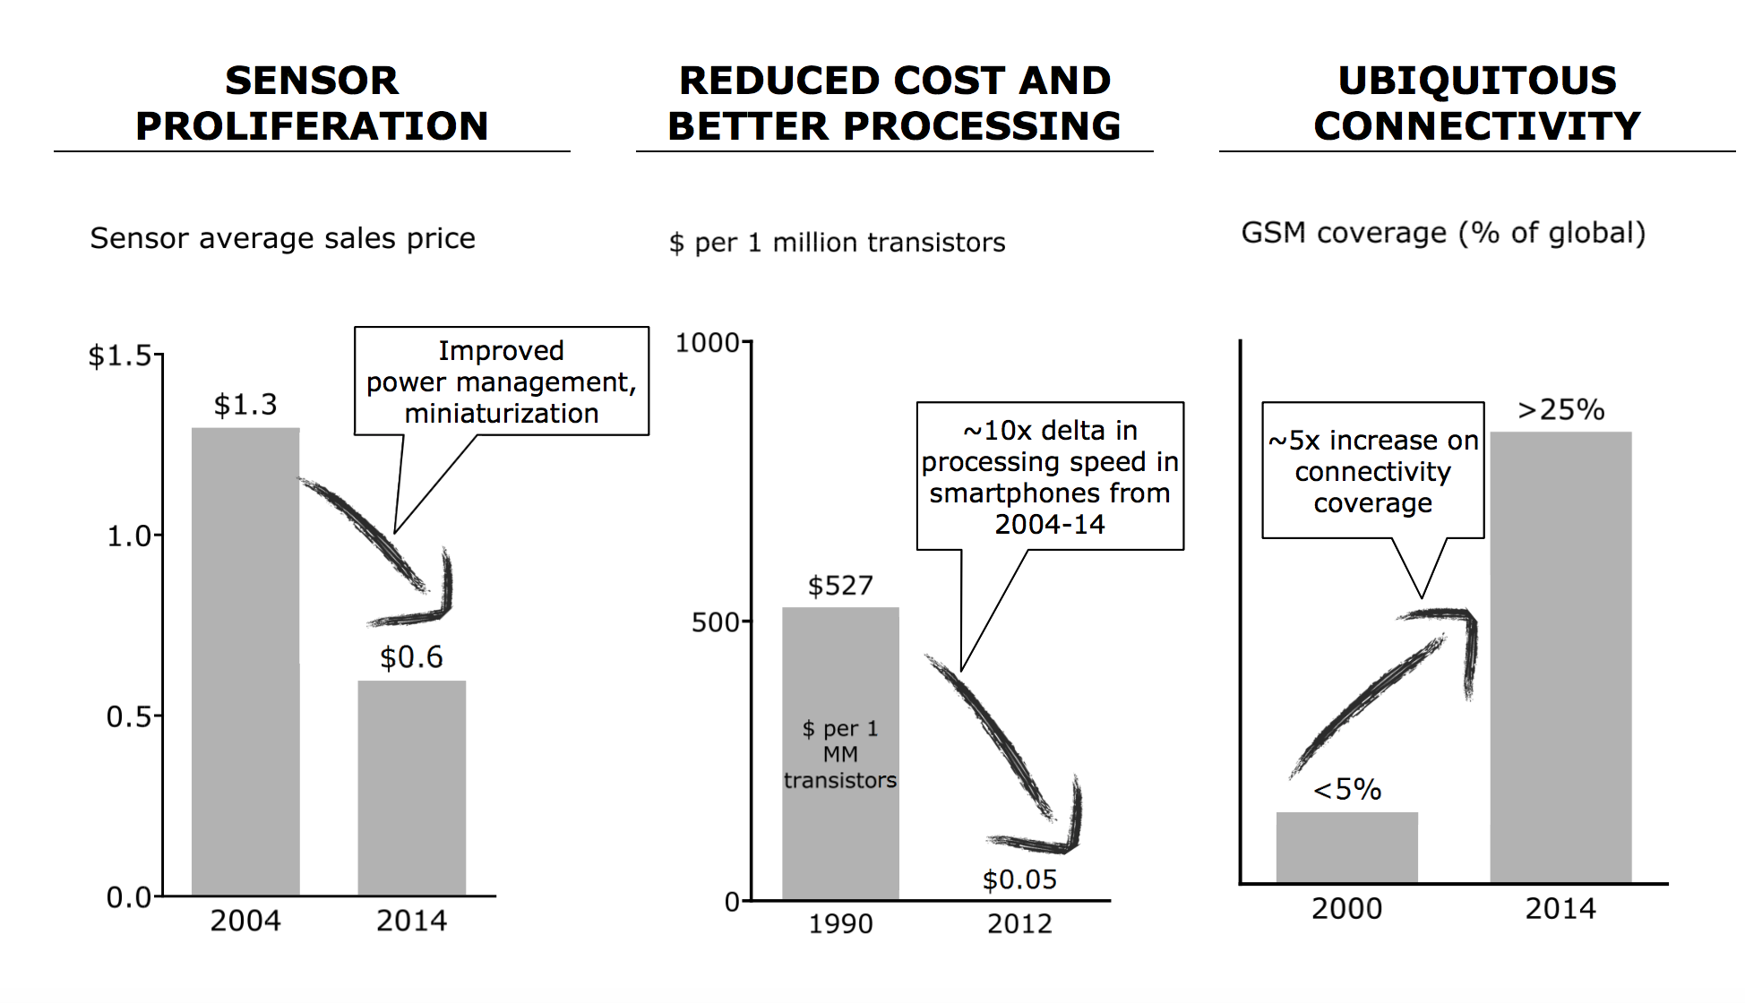

Slide 20
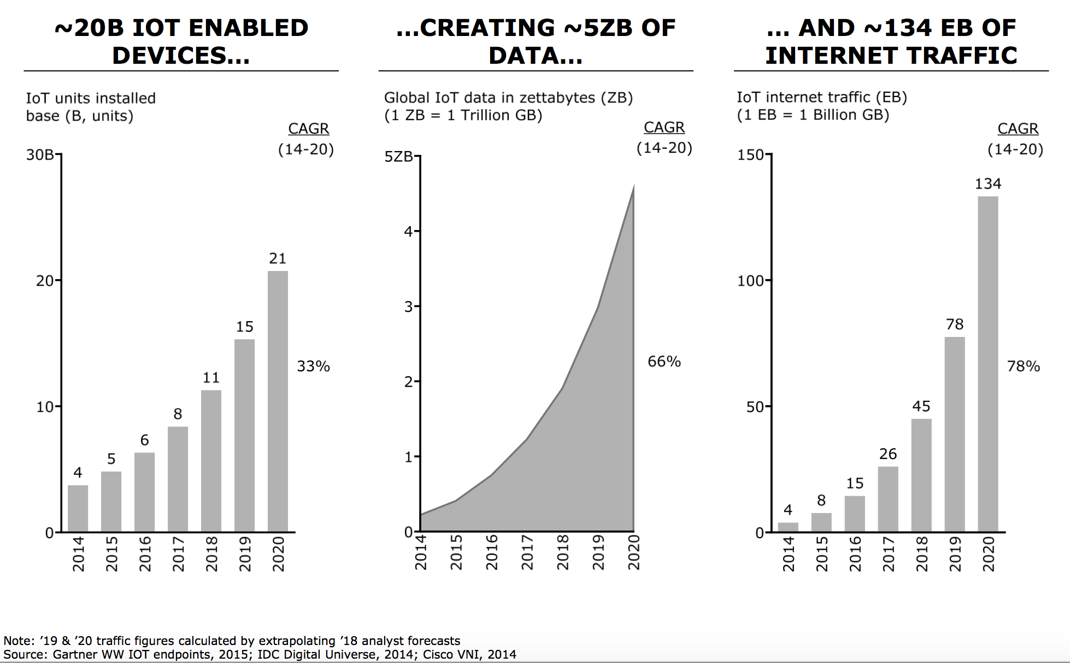
IOT/Analytics =>
massive amounts of data /traffic
1 ZB =
10⁹ TB

Slide 21
Relevant across all Industry Segments
Personal (devices worn by consumers)
Use cases: Wellness/ fitness monitoring, smart baby monitor, etc.
Home (devices in homes)
Use cases: Home automation, energy management, connected security, etc.
Automotive (In cars/ light trucks interacting w/consumers)
Use cases: In-vehicle infotainment (IVI), Advanced Driver Assistance Systems (ADAS), remote access, telematics, etc.
Healthcare (Systems/ devices for patient, provider, payer value chain)
Use cases: Trial monitoring, personalized medicine, etc.
Building, Retail, Infrastructure, …

Slide 22
IOT for cost savings + revenue generation
Increase reliability of operations
Increase QoS or product
Increase asset productivity
Increase workforce productivity
Increase customer satisfaction to reduce costs
Improve time to market
Reduce waste/cost of materials
New insights…

Slide 23
IOT Problems
Cost & complexity:
“Smart” lamps, thermostats, bulbs, …
Environmental Cost:
E-waste, batteries, products with limited lifespan,…
Security:
Fails due to shoddy engg.,
Tesla-S buffer overflow
Amazon Ring camera
Privacy:
“Free” means that usage data is being monetized
Battery life:
Wireless communication is generally very expensive!
Network:
Typical COTS internet-enabled solns use 3G/4G, WiFi, BLE
Except for BLE, unacceptably power hungry at the edge

Slide 24
IoT brings Disruption
Disruption good for entrepreneurs
Entrepreneurs embedded in opportunity
We need to train students with skills
HOW ??

Slide 25
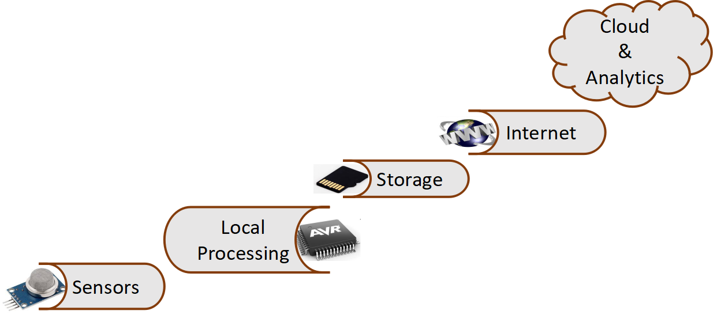

What is Internet of Things (IoT)?
MQTT
CoAP
SD Card
Drive
Analog
Digital
I2C, UART,SPI, etc..
Image courtesy: Google image

Slide 26
Embedded System Diversity

Slide 27
Common Design Metrics
NRE (Non-recurring engineering) cost
Unit cost
Size (bytes, gates)
Performance (execution time)
Power (more power=> more heat & less battery time)
Flexibility (ability to change functionality)
Time to prototype
Time to market
Maintainability
Correctness
Safety (probability that system won’t cause harm)

Slide 28
Challenges
…Decreasing
Mission & Safety-Critical Pressures
Increasing…
Safety critical requirements in
Aerospace & defence, Energy Transportation, Industrial, Medical
Requirement changes, life span
Application complexity
Cost of code testing, validation & verification & certification
Need for systems & software design reusability
Packaging & ergonomics are key
Mechatronics
Mass deployment – less scope for error
Tolerance for defects
Development Cycles
Resource availability
Ability to manage reqs
Ability to ensure long term maintenance

Slide 29
Current Technology
Extrapolation of traditional software techniques
Programs written in conventional languages
C subsets, MISRA C for automobile
Java for telephone / smartcards
Glued together by OS services
A wide variety of embedded OS (VxWorks, OSEK)
With some reuse and standardisation effort
Classical software models largely inadequate
Too powerful, hard to verify
often subsets of rich languages=>doesn’t make them simpler

Slide 30
Why Is Embedded Software Not Just Software On Small Computers?
Embedded = Dedicated
Interaction with physical processes
Sensors, actuators, processes
Critical properties are not all functional
Real-time, fault recovery, power, security, robustness
Heterogeneity
Hardware/software tradeoffs, mixed architectures
Concurrency
Interaction with multiple processes
Reactivity
Operating at the speed of the environment
These features look more like hardware!
Notes:
10
Another definition for embedded systems:
Embedded = dedicated
Fixed functionality – No general purpose
Fixed in Hardware

Slide 31
Current Bottleneck
Intrinsic application complexity grows rapidly
Analog / digital interface: more objects to control
Embedded algorithmics: signal, display, alarm, power...
Richer hardware architecture: μP, DSP, ASIP, ASIC, FPGA
Performance adds complexity
Footprint / power minimization interferes with logical design
Technology independence is still difficult
=> Verification bottleneck
Applications hard to verify off-site
Hardware / software interaction difficult

Slide 32
Apple A.. SoC series
Apple A4 (2010)
for iPad ARM based SoC @1GHz w/integ. GPU ($1Bn to devlp)
Apple A5 (2012)
Based on dual-core ARM Cortex-A9 MPCore CPU
$4B development facility by Samsung in Texas
Clocked at 1 GHz (auto adj. frequency to save battery)
ISP for face detection, wh.balance & automatic image stabilization
”EarSmart" unit from Audience for noise canceling
CPU portion 2x as powerful as the original iPad
GPU up to 7x as powerful A4
Cost 75% more than predecessor
Apple A6x (2013)
1.4 GHz Apple-designed ARMv7 based dual-core CPU (Swift)
Integrated quad-core PowerVR SGX 554MP4 GPU @300 MHz
2x computing power + graphics perf. Of previous Apple A5X
32 nm process => chip is 123 mm² large^{[6]} (26% larger than A6).
Notes:
Refresh
10

Slide 33
(Apple) Processor Trends
Year | Model | Specs | Product | Spd | Gfx | Size | Tech.
2012 | A6 | 1.3 GHz ARMv7 based dual-core CPU (Swift) | iPhone5 | 2x | 2x | 22% smaller | 32nM
2013 | A7 | 1.3–1.4GHz 64-bit ARMv8-A dual-core CPU (Cyclone) integrated PowerVR G6430 GPU, 31x64bit GP regs, 32x128bit FP regs | iPhone 5S, iPad Mini2 & 3 | 2x | 2x | 1B transistors in 102sq.mm | 28nM
2014 | A8 | 1.4GHz 64-bit ARMv8-A dual-core CPU & integrated PowerVR GX6450 GPU | iPhone6 & 6+ | 25% | 50% | 13% less in size, 2B transistors 89sq.mm | 20nM
2015 | A9 | 64-bit ARM based system on a chip (SoC) | iPhone 6S & 6S+ | 70% more | 90% more |  | 14nM

Slide 34
(Apple) Processor Trends
Year | Model | Specs | Product | Spd | Gfx | Size | Tech.
2016 | A10 | 64-bit ARMv7 based SoC quad-core CPU (Fusion) | iPhone 7 | 40% faster | 50% faster | 3.3B transistors | 16nM
2017 | A11 | 64-bit ARMv8-A 6-core CPU (Bionic) 2 high perf and 4 high efficiency | iPhone 8 | 25% faster | 70% faster | 4.3B transistors | 10nM
2018 | A12 | 64-bit ARM 2+4 core CPU (Bionic) | iPhone XS & XR | 35% faster | 95% faster multi core | 6.9B transistors | 7nM
2019 | A13 | 64-bit ARM 6 core with 2 high perf cores running at 2.65GHz (Lightening) with ML accelerators – AMX blocks; & 4 energy efficient cores (Thunder) | iPhone 11 | 20% faster with 30% less pwr | 20% faster with 40% lower pwr | 8.5B transistors | 7nM

Slide 35
Software Engineering (or, how do we build reliable systems?)
Notes:
10

Slide 36
Things Have to Change!
Pressure on productivity of design engineers working on complex systems.
Time has come to design hardware using software engineering - rather than hw engg - methodologies.
Complexity of system is the basic problem, and Moore’s Law doubles complexity every 18 months.
Advances in software engineering help produce complex systems with more easily available design skills, making large profits
We expect new designers, with/without hardware design skills, will design hardware in future

Slide 37
Designer Productivity
“The Mythical Man Month” by Frederick Brooks ’75
More designers on team => lower productivity because of increasing communication costs between groups
Consider 1M transistor project: - Say, a designer has productivity of 5000 transistor/mth - Each extra designer => decrease of 100 transistor/mth productivity in group due to comm. costs
1 designer 1M/5000 => 200mth
10 designer 1M/(10*4100) => 24.3mth
25 designer 1M/(25*2600) => 15.3mth
27 designer 1M/(27*2400) => 15.4mth
Need new design technology to shrink design gap
Source: Embedded System Design: Frank Vahid/ Tony Vargis (John Wiley & Sons, Inc.2002)
Notes:
Refresh
10

Slide 38
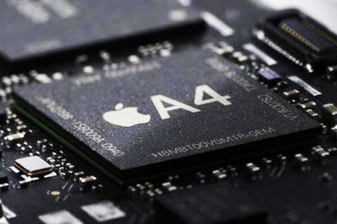
Design Productivity Gap
Designer productivity grown over the last decade
Rate of improvement has not kept pace with the chip-capacity growth
1981: leading edge chip:
100 designers * 100 trans/mth => 10k trans complexity
2010: leading edge Intel chip using 45nM technology:
> 1B transistor complexity
2015: Leading edge Apple A9 using 14nM technology:
> 2B transistor complexity
2019: Apple A13 chip using 7nM technology:
> 8.5B transistor complexity
Designers at avg. of $10k pm => cost of building leading edge chips has gone from $1M (1981) to $300M (2002) to $1B (2010) to …
Apple A4 for iPad ARM based SoC @1GHz w/integrated GPU ($1Bn to develop)
Need paradigm shift to cope with complexities
Source: Embedded System Design: Frank Vahid/ Tony Vargis (John Wiley & Sons, Inc.2006)
And others.
Notes:
Refresh
10

Slide 39
Chip Design Cost

Slide 40
Time to Market Design Metric
Simplified revenue model
Product life = 2W, peak at W
Time of market entry defines a triangle, representing market penetration
Triangle area equals revenue
Loss
The difference between the on-time and delayed triangle areas
Avg. time to market today = 8 mth
1 day delay may amount to $Ms
see Sony Playstation vs XBox
Peak revenue
Peak revenue from delayed entry
Revenues ($)
On-time
Market rise
Market fall
Delayed
D
W
2W
On-time Delayed
entry entry
Time
Source: Embedded System Design: Frank Vahid/ Tony Vargis (John Wiley & Sons, Inc.2002)

Slide 41
Losses due to delayed market entry
Area = 1/2 * base * height
On-time = 1/2 * 2W * W
Delayed = 1/2 * (W-D+W)*(W-D)
Percentage revenue loss = (D(3W-D)/2W²)*100%
Try some examples
Peak revenue
Peak revenue from delayed entry
Revenues ($)
On-time
Market rise
Market fall
Delayed
Lifetime 2W=52 wks, delay D=4 wks
(4*(3*26 –4)/2*26^2) = 22%
Lifetime 2W=52 wks, delay D=10 wks
(10*(3*26 –10)/2*26^2) = 50%
Delays are costly!
D
W
2W
On-time Delayed
entry entry
Time
Source: Embedded System Design: Frank Vahid/ Tony Vargis (John Wiley & Sons, Inc.2006)

Slide 42
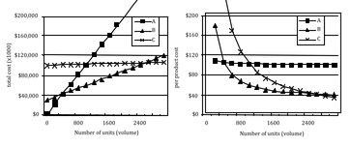
NRE and unit cost metrics
Compare technologies by costs -- best depends on quantity
Technology A: NRE=$2,000, unit=$100
Technology B: NRE=$30,000, unit=$30
Technology C: NRE=$100,000, unit=$2
But, must also consider time-to-market
Source: Embedded System Design: Frank Vahid/ Tony Vargis (John Wiley & Sons, Inc.2002)

Slide 43
Software Engineering… Why we need it?

Slide 44

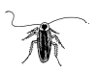

Enemy number 1 : the bug
Therac 25 : lethal irradiations
Dharan's Patriot
Ariane V
Mars Explorer, Mars Polar Lander
High-end automobile problems
Pentium, SMP cpu networks
Telephone and camera bugs
Bugs grow faster than Moore's law!

Slide 45
Other Important Issues
Hardware / software partitioning
Hardware / software source code independence
Link between programming and performance analysis
Operating Systems / scheduling
Well-studied field: rate-monotonic, earliest deadline first, etc.
Newer computation models need less explicit scheduling
Fault tolerance
Software redundancy, voting algorithms, etc.
CRCs, TT networks

Slide 46
How to avoid or control bugs?
Traditional : better verification by fancier simulation
Next step : better design using specific techniques
Better and more reusable specifications
Simpler computation models, formalisms, semantics
Reduce architect / designer and customer / provider distance
Reduce hardware / software distance
Requires better tooling
Higher-level models and synthesis
Formal property verification / program equivalence
Certified libraries

Slide 47
Anatomy of Embedded Applications
CC : continuous control, signal processing
Differential equation solving, filters
Specs and simulation in Matlab / Scilab, manual or automatic code
FSM : finite state machines, state transition systems
Discrete control, protocols, networking, drivers, security, etc.
Flat or hierarchical state machines, manual or automatic code
Calc : calculation intensive
Navigation, security, etc.
C, manual + libraries
Web : web-like navigation, audio / video streaming
Consumer electronics, infotainment systems
Data-flow networks, embedded Java

Slide 48
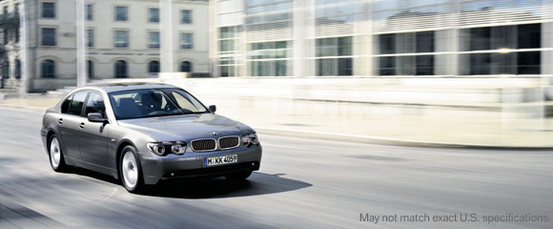
BMW 745i : Prelude To Complexity
Another Life Cycle Example : The Software Error
Notes:
10

Slide 49
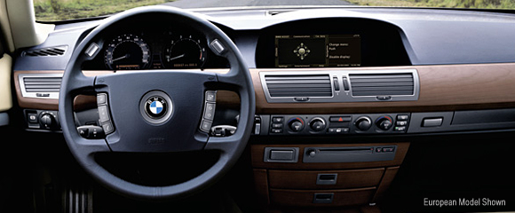
External view
The problem: software error, a desynchronization
of the valvetronic motors
“Engine malfunction,
drive with moderation”
Rough running engine, possibly stall
Severity: 6 incidents in 5,470 cars with 2 rear endings
“alleged injury” of BMW passengers
Fault of drunk or inattentive following drivers

Slide 50
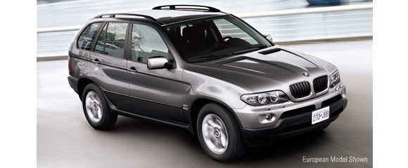
BMW Cost
To repair: Reprogram ECU
Recalls not uncommon in industry
BMW 5,470 cars @ $68,500 = Rev $372 mil
Compare Cost: Recall BMW X5
164,000 units @ $66,800 = Rev $10 bil.
~$5 Million
~$30 per SUV

Slide 51
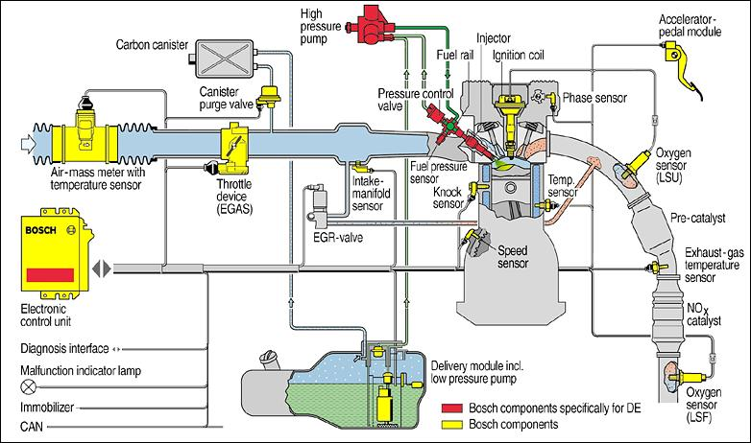
Bosch EMU For Four Wheeler ( Multi Cylinder)
Source: Bosch Brochure : Ref 6
Notes:
10

Slide 52
Design Issues (How do we build these systems?)
Notes:
<number>

Slide 53
Functional Design & Mapping
F2
Functional Design
F1
F5
F4
Source: Ian Phillips, ARM
VSIA 2001
F3
(F2)
Architectural Design
(F5)
Thread
HW1
(F3)
(F4)
HW2
HW3
HW4
RTOS/Drivers
Hardware Interface

Slide 54
Synchronous languages
Started in the 80's
Esterel : Ecole des Mines / INRIA, SyncCharts : U. Nice
Lustre : IMAG, Signal : INRIA Rennes
Lava : Chalmers, Xilinx
Started in the mid-90's
Handel-C: University of Oxford, Celoxica Inc.
Industrial use in the 90's
Lustre / SCADE : nuclear plants (Schneider), avionics (Airbus)
Esterel : avionics (Dassault), telecom
=> Full development in the 2000's
avionics: Airbus, Dassault, Elbit, Eurocopter, SNECMA, Thales,...
automotive: AUDI, GM, PSA,...
hardware pilot projects / experiments: TI, STM, Xilinx, Intel, Thales
Notes:
Drop
<number>

Slide 55
Trends
Moore’s Law
IC transistor capacity doubles every 18 mths
1981: leading edge chip had 10k transistors
2002: leading edge chip has 150M transistors
2010: Leading edge Intel processor has 0.5B trans in 107sq.mm
2014: Leading edge Intel processor has 2.0B trans in 89sq.mm
2019: Leading edge Intel processor has 8.5B trans in 83sq.mm
Why? reducing trans size, increasing chip size, clever circuits
Changing due to paradigm shifts: sys design tools, nanotech, ...
Designer productivity has improved due to better tools:
Compilation/Synthesis tools
Libraries/IP
Test/verification tools
Standards
Languages and frameworks (Handel-C, Lava, Esterel, …)
1981: designer produced 100 transistors per month
2002: designer produces 5000 transistors per month
2020: designer produces ???
Notes:
Drop?
<number>

Slide 56
How do we get there?
KNOWLEDGE OR SKILLS REQUIRED
Design of Solutions
Investigation
Modern Tool Usage
Individual & Team Work
Communication

Slide 57
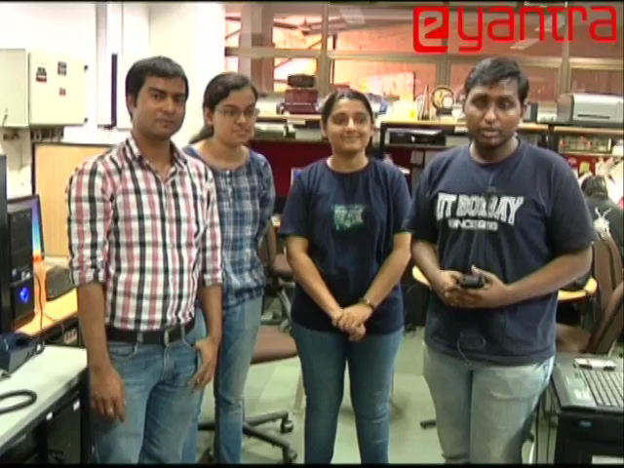

Slide 58
Academic Program (Minor?)
M.Tech. Course:
CS684 Embedded Systems (Software) / Sem 2
Background required: Basic understanding of Operating Systems at UG level C programming
Related courses:
EE617 Sensors in Instrumentation / Sem 1
EE616 Electronic System Design / Sem 1
EE712 Embedded Systems Design / Sem 2
CS684: Takeaways
Insight into system design for embedded/ time-critical apps
The satisfaction of building (hw/sw) system to solve a problem

Slide 59
Guidelines (CS684)
Compulsory Labs (on Wed):
7 labs (introduction to Embedded Systems)
Compulsory Workshop (on 2 Sat):
Introduction to IoT System Building
Evaluation
10% Quiz, 10% Assignments, 10% 2 weekend wkshp, 10% Wed. labs, 40% Project (with 10% project-based endsem/individually assessed), 20% Midsem
Surprise quizzes
Percentages may be tweaked as we progress
Project seeded pre-midsem, implemented post midsem

Slide 60
Course Details (No Audit)
Mail ids:
Moodle based interaction with TAs
Faculty: kavi@cse.iitb.ac.in
Assignments
On Moodle - subscribe to 'CS 684' on Moodle
http://moodle.iitb.ac.in
Lab team:
Lohit, Kalind, Rutuja, Omkar, Kedar
Workshop Team:
Lohit, Omkar, Avijit, Vikrant, Andrea, Rutuja
CS684 TA:
Diptesh Kanojia (Lead TA) diptesh@cse...

Slide 61
Microcontroller Labs
Dates:
Wednesdays (beginning 22nd Jan., Intro on Thu. 16 Jan.)
Introduction to Microcontroller concepts
Intro to Atmega2560, Peripherals and Visual Studio Code
Understanding GPIO and Peripherals of Atmega2560
Interrupts/Timers, PWM and Servo Motor Interfacing
Introduction to RTOS using ESP32 Microcontroller
ADC/Interfacing Joystick
Applications:
Automation
IoT

Slide 62
Conclusion
We have simultaneous optimisations of competing design metrics: speed, size, power, complexity, etc.
We need a “Renaissance Engineer”
w/holistic view of design process & comfortable with technologies ranging from hw, sw to formal methods
Maturation of system-building tools
Enables unified view of hardware/ software co-design.
Design efforts focus at higher levels of abstraction => Abstract specifications refined into programs then into gates and logic.
There is no fundamental difference of between what hardware and software can implement.

